Slide 1
Taking Root Data Analyst Take Home Exercise
Victor Denisov

Slide 2
Executive Summary
Situation:
Field survey carbon estimates are based on extrapolations of sampled parts of land. If overlaps of land exist then overestimation of carbon occur due to double counting.
This leads to unfavourable outcomes like jeopardizing Taking Root’s credibility in the market and operational inefficiencies in fixing these overlaps.
Objective:
Identify data quality issues with overlaps of land to minimize efforts of remapping
Assist project managers to create action plans with partners to mitigate future issues
Recommendation:
Restructure the process of data transformation to include a unique key identifier for each land parcel
Create a classification process to implement new tooling that flags new parcel data with >20% overlapped area vs. existing parcels
Risks:
- Doesn’t exactly fix the core problem of duplicate data occurring in the data collection process, need more details from project team to investigate the issue
- Inherent assumption that Parcel A is not always equivalent to Parcel B
Next Steps:
- Work with data engineering to establish a process for unique key identifiers for each land parcel
- Implement new tools that flag similar parcel data and a process where project managers can visually identify duplication

Slide 3
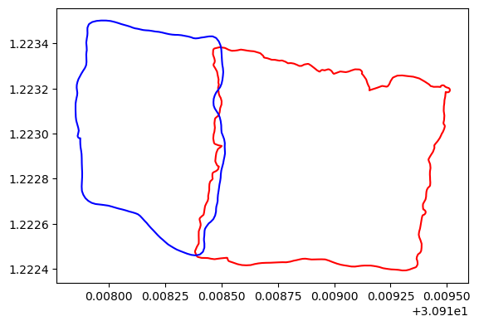
Example 1: Minimal Overlap
ID: 0
ParcelA in Red
ParcelB in Blue
The total overlapped area in this example is ~2%
~40% of the data

Slide 4
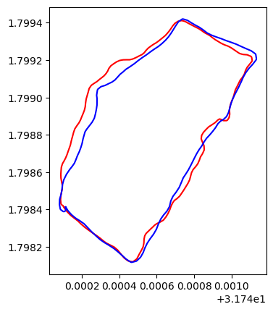
Example 2: Significant Overlap
ID: 229
ParcelA in Red
ParcelB in Blue
The total overlapped area in this example is ~89%
~59% of the data

Slide 5
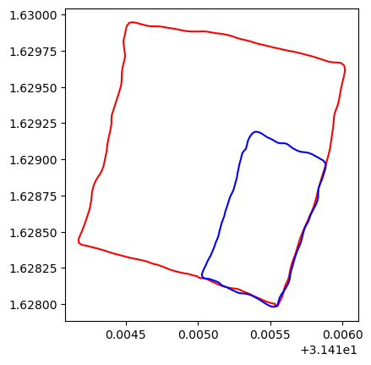
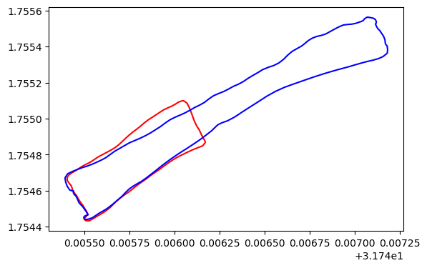
Example 3: Extension Area
Left ID: 227
Right ID: 24
ParcelA in Red
ParcelB in Blue
The total overlapped area in these examples are ~40% and ~24%
~1% of the data

Slide 6
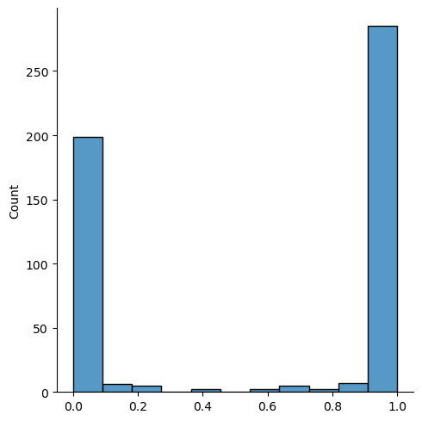
Overlap Area Distribution
Ex. 2
This inverted bell curve distribution describes the frequency of overlapped areas between two parcels of land as a percentage.
The majority of the data either has very few overlaps or has a significant amount of overlaps
This data is calculated by finding the intersection of parcel A and parcel B, calculating the area of the intersection, and then comparing it to the area of parcel A
Ex. 1
Ex. 3
Percent of Overlapped Area

Slide 7
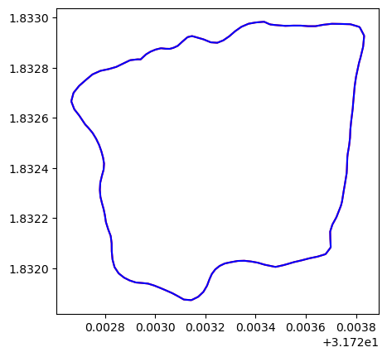
Data Investigation, ID: 12
ParcelA in Red
ParcelB in Blue
The total overlapped area in this example is exactly 100%
This means that there are duplicates in the data - in fact, there are only 440 out of 1026 unique parcels of land (satisfying that overlapping land area is >40%)

Slide 8
Data Investigation, ID: 12
Further investigation reveals the following:
Index 12
Duplicate index A [12, 13, 14, 15, 17, 18, 19]
Duplicate index B [9, 10, 12]
Since parcel A and parcel B are the same, this means that all duplicates of A and duplicates of B are also the same
So set A[12, 13, 14, 15, 17, 18, 19] are all the same as set B[9, 10, 12]
This also means that neighbours of set A are the neighbours of set B and vice versa

Slide 9
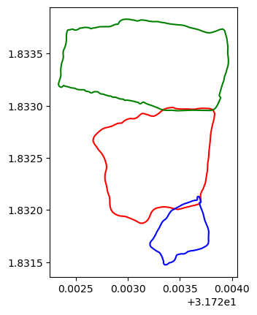
Data Investigation, ID: 12
Index 12
Duplicate index A [12, 13, 14, 15, 17, 18, 19]
Duplicate index B [9, 10, 12]
12A is duplicative of 12B (red)
13B is a neighbour of 12A (blue)
14B is a neighbour of 12A (green)
9A, 10A, 17B are duplicates of 13B (blue)
15B, 18B, 19B are duplicates of 14B (green)

Slide 10
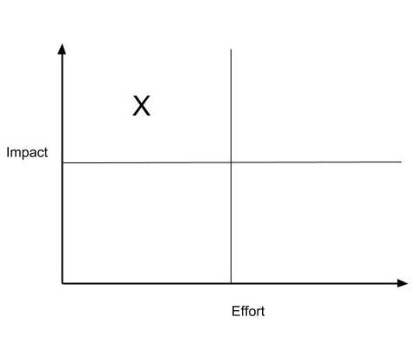
Solution: Focus on Improving Data Extraction and Transformation
Proposal
1
1. Data Extraction
- Conduct user interviews to understand how parcel data is ingested and create a process to minimize duplication
- Effort: Medium
- Impact: High
2
3
2. Data Transformation
- Coalesce all duplicate parcel IDs to create a unique identifier based on date of creation and identify its neighbours
- Effort: Low
- Impact: Medium
3. Data Validation
- Create a tool for project managers to flag new data as duplicate, extension, or neighbours of
- Effort: Medium
- Impact: Medium
Prioritization:
Work on proposal 2 for a quick win, if time permits focus on proposal 1 to identify root cause and 3 concurrently

Slide 11
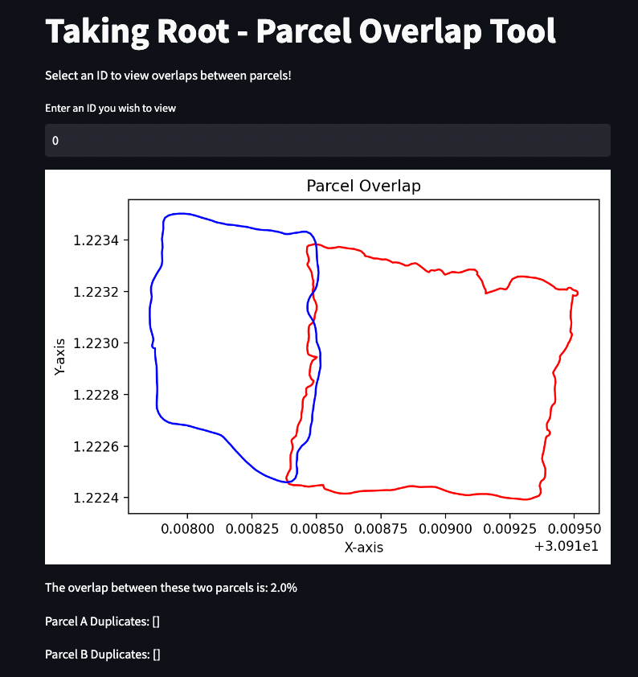
Solution: Parcel Overlap Tool
Demo Time!

Slide 12
Risks and Next Steps
Risks
Doesn’t exactly fix the core problem of duplicate data occurring in the data collection process, need more details from project team to investigate the issue (user interviews)
Inherent assumption that Parcel A is not always equivalent to Parcel B
I assume that they are neighbours and thus both should be counted, but this could be a false assumption. Perhaps Parcel B is a remapping of Parcel A due to environmental changes of the landscape or another good reason for this to occur
Additional engineering resources required, prioritization may take time to implement these solutions
Next Steps:
Work with data engineering to establish a process for unique key identifiers for each land parcel
Create a process that identifies which duplicate to use as the primary
Understand the graph of neighbours to build a concise model of geographical dependencies based on unique identifiers
Implement new tools that flag similar parcel data and a process where project managers can visually identify duplication
Understand the process of data ingestion and how this tool can fit to improve data collection

Slide 13
Thank You
Victor Denisov

Slide 14
Appendix

Slide 15
Solution: Focus on Improving Data Extraction and Transformation
Current
Current Table
id | pair_a | pair_b
12 | POLYGON ((31.7234581283977 1.83297173912079, 3.. | POLYGON ((31.7234581283977 1.83297173912079, 3...
Proposed
Using the existing data collection process, create a set of unique identifiers based on date of collection and their duplicates
id = prev_id
id | Duplicates | Neighbours | Latest Date Collected | Primary | Prev_ID
12A | 12B, 13A, 14A, 15A, 17A, 18A, 19A | 13B, 14B, 15B, 17B, 18B, 19B, 9A, 10A | 1/1/2023 00:00:000 | 1 | 12
12B | 9B, 10B | 13B, 14B, 15B, 17B, 18B, 19B, 9A, 10A | 1/1/2023 00:00:000 | 0 | 12
Proposed Table
- This doesn’t exactly solve the problem - we still don’t know why we have so many duplicates. But we can create a graph to build a representation of “who is who in the zoo” and assign unique identifiers for duplicates that temporarily address the problem (Data Transformation Improvement)
- It would be much more thorough to identify how these duplicates occur. Are they an update of existing parcels of land or are they neighbours? Through this classification, we can determine which “duplicate” to use moving forward as the “primary” (Data Extraction Improvement)

